Slide 1
Multi Site Damage
Multi-Site Damage is the multiple crack problem in the riveted structure of an aircraft skin. The reason behind Aloha Airlines Boeing 737-200 ( April 1988) accident is multiple site damage of a riveted lap joint of skin caused by corrosion fatigue.

Slide 2
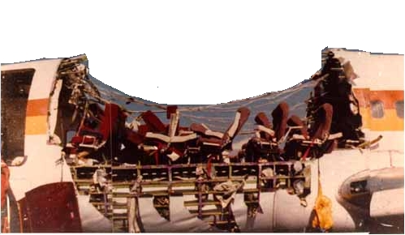
Aloha airlines accident

Slide 3
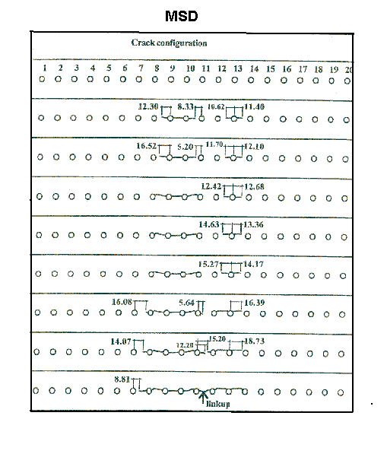
MSD- Crack initiation and link up from a single row of rivet holes

Slide 4
The physics behind MSD
Aircraft cabin pressurization and depressurization cycle due to high altitude operation creates a fatigue loading for the multiple cracks. The crack growth rate can be predicted using the formula.

Slide 5
Formula to predict the crack growth rate
Where is the crack
growth per cycle, is stress intensity range, C, m, are material constants.

Slide 6
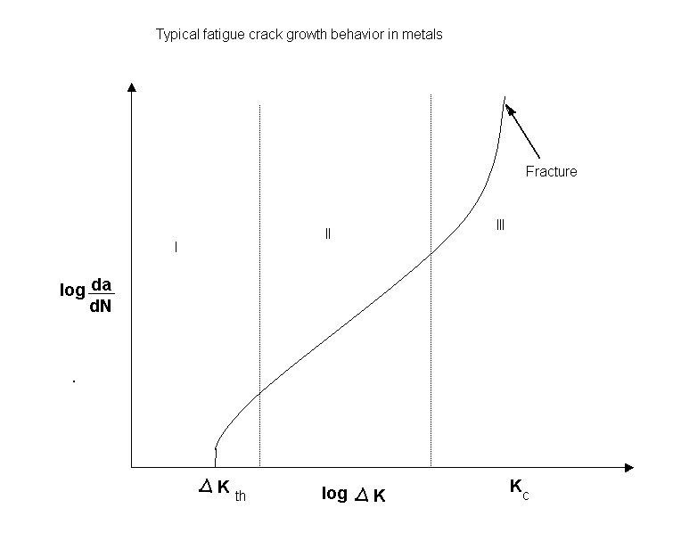
Fatigue crack growth of a component

Slide 7
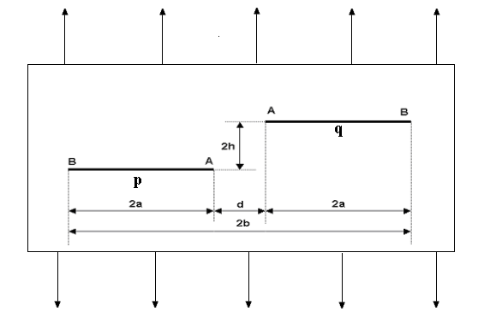
Two equal parallel eccentric through cracks under far field tension

Slide 8
MSD Software
The software can be used to calculate the criticality of cracks and decide whether any repair is required to be done to avoid any fatality and safe flying hours can also be calculated before next inspection.

Slide 9
Conference Paper
V. Rangasamy, X. Wang and R. Bell “On the Analysis of Crack Interactions Using Weight Function Method”, International conference on Ocean Mechanics and Arctic Engineering, 2002,Department of Mechanical and Aerospace Engineering, Carleton University, Ottawa, Ontario, Canada.

