Slide 1
Ingenious Design Technologies
Researching for optimum

Slide 2
Industry Verticals
Aerospace
Home appliances
Automotive
Agricultural equipments
Heavy Machinery
Medical Equipments
Ship Building

Slide 3
Vision:
To lead Engineering industry by introducing the latest CAE technology from abroad in technology migration to India and to contribute to the welfare of society by directly employing the young and vibrant engineers of India.
Mission:
To perform computer aided engineering design tasks with a group of Associates who have specialized in various industry verticals.

Slide 4
Computer Aided Engineering Design Services
Stress analysis (Linear & Non-Linear)
Meshing for automotive crash analysis (Shell Meshing)
Component or product meshing (Hex & Tet Meshing)
Dynamic Analysis (Drop test & Impact)
Design optimization (DoE based)
Thermal and Structural coupled analysis
Durability & Fatigue analysis
Vibration analysis (Modal & Harmonic)
Manufacturing process simulation (Casting, Sheet metal & Forging)
Computational Fluid Dynamics (CFD)
Fluid Structure Interaction (FSI)

Slide 5
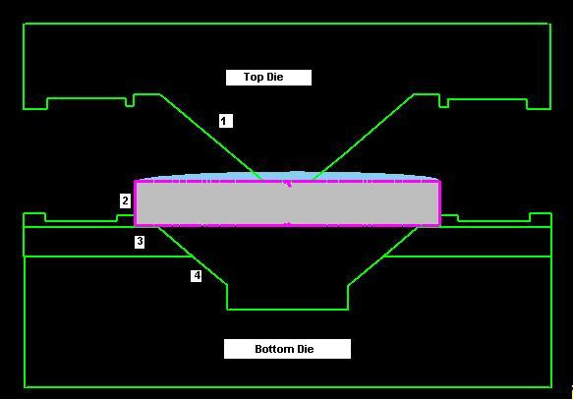
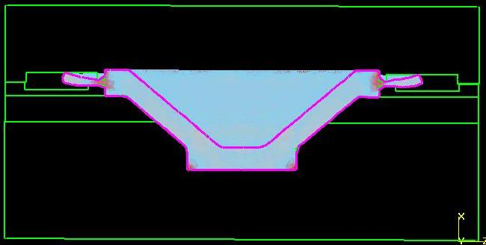
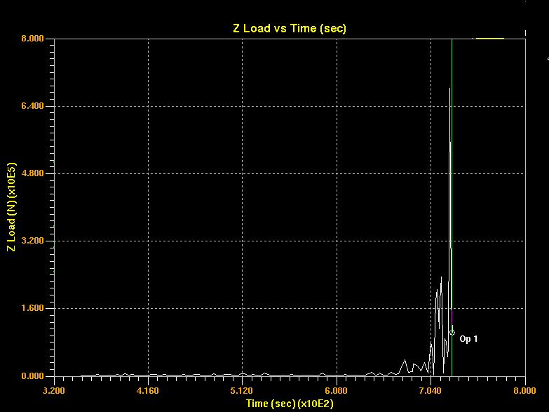
Aerospace
Forging Die Design and Simulation of a Aerospace Component
Preform, top and bottom die
Forged component with dies
Load - Stroke Curve

Slide 6
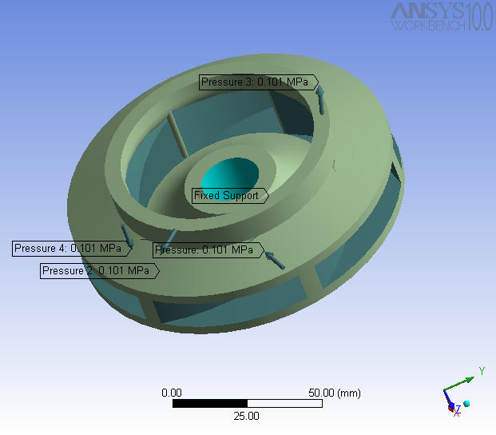
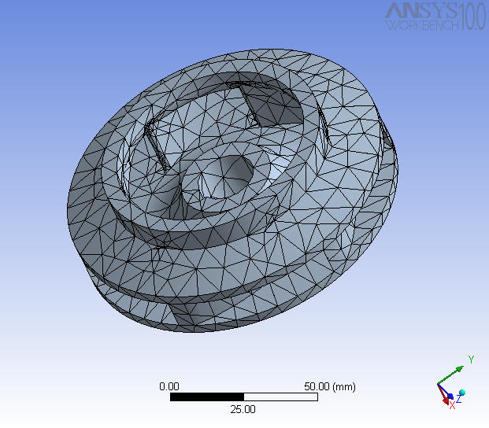
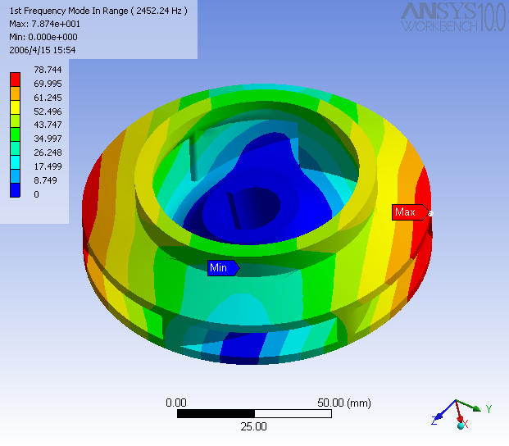
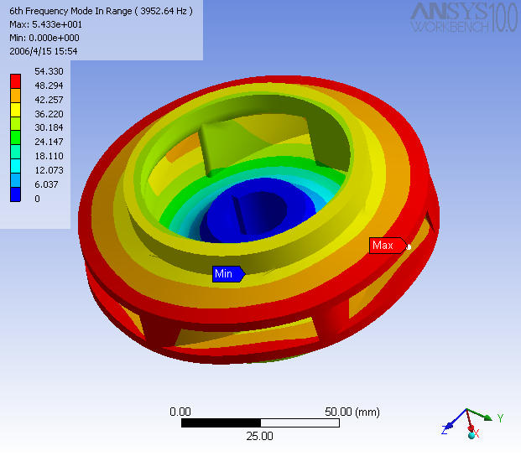
Home Appliances
Vibration analysis of a Pump impeller
Impeller Model
Meshed Impeller
Vibration mode I
Vibration mode II

Slide 7
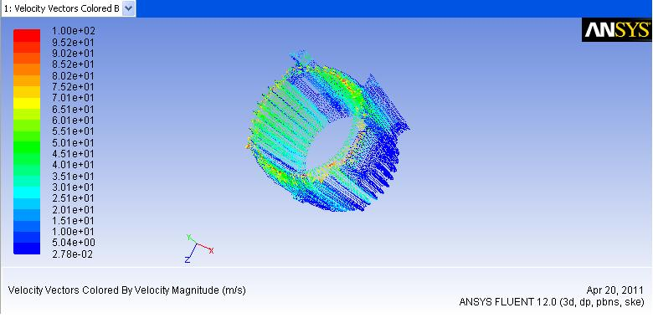
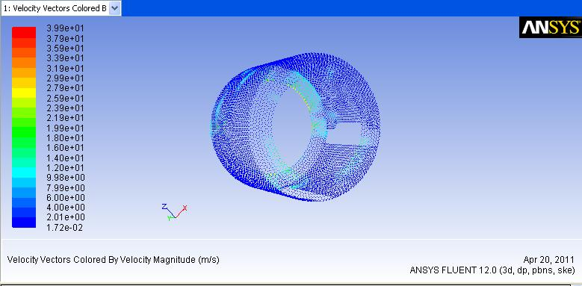
CFD of air flow over Stator by cooling fan with terminal box obstruction
Home Appliances

Slide 8
Submersible pump shaft vibration analysis
Home Appliances

Slide 9
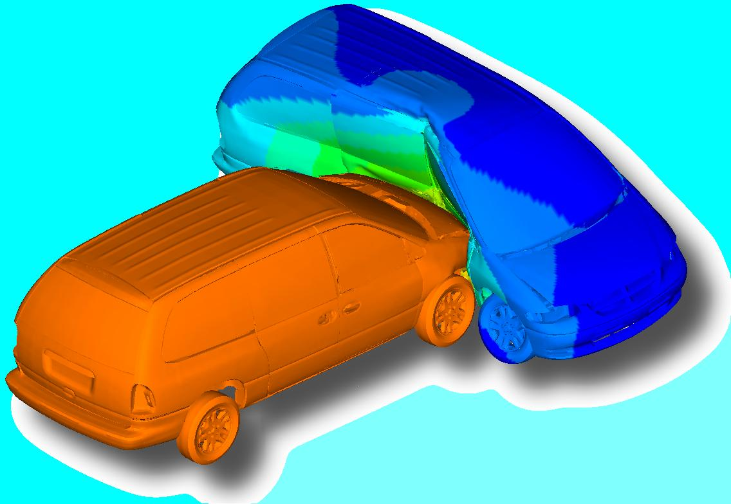
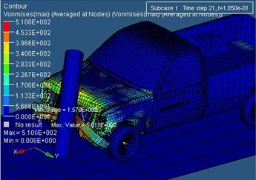
Automotive Crash – Side & Frontal impact
Automotive
Side impact
Frontal impact

Slide 10
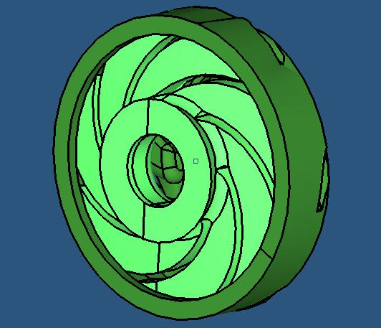
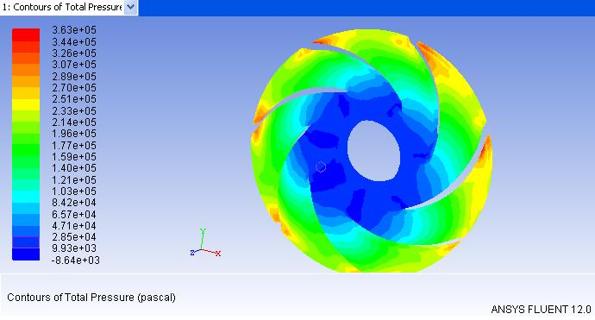
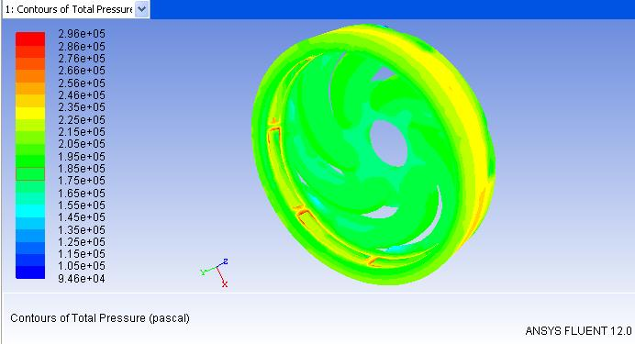
Agricultural Equipments
CFD of a single stage of Submersible Pump
Impeller & Diffuser
Impeller & Diffuser Mesh
Impeller pressure
Diffuser pressure

Slide 11
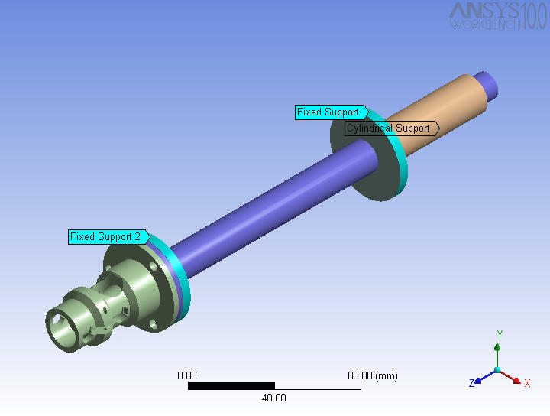
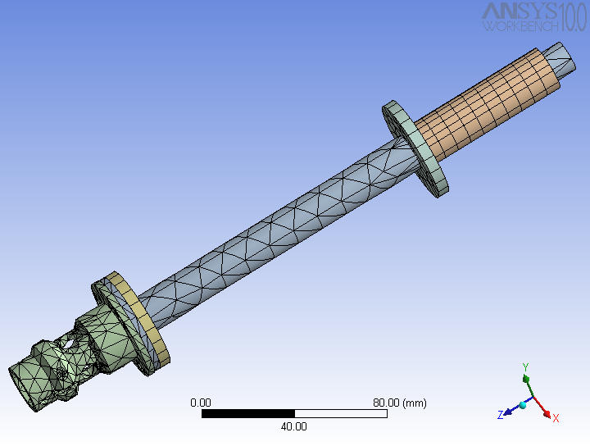
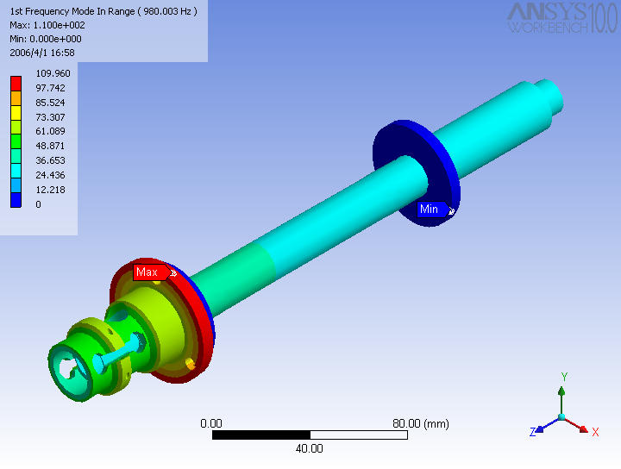
Stress analysis of a Spindle Assembly
Heavy Machinery
Spindle Model
Meshed Spindle
Spindle Stress plot

Slide 12
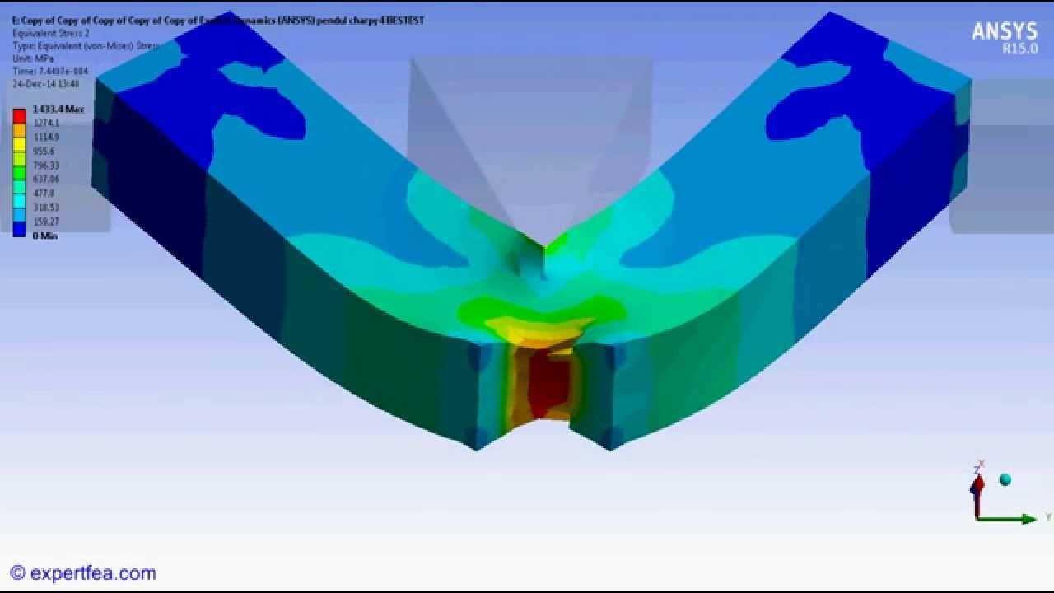
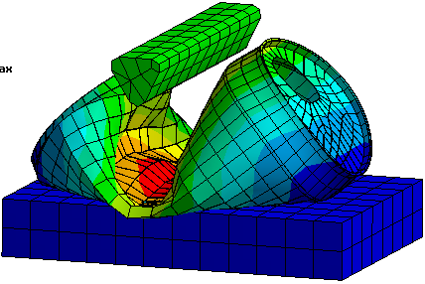
Fracture & Drop test & Damage tolerance

Slide 13
Contact
Web: www.ingeniousdesigntech.com
INDIA
Ingenious Design Technologies,
1/69, Palani Gounder Colony,
NGGO Colony,
Coimbatore,Tamilnadu,
India – 641 022.
Principal Consultant :
Vimal Krishna R
Cell: +91 80 56 88 88 63

Slide 14
NORTH AMERICA – USA
Ingenious Design Technologies,
1095, Robert Dr.,
Columbus,
Indiana - 47201
Consultant :
Nanda Methil S
Cell: +001-734-7173349
NORTH AMERICA – CANADA
Ingenious Design Technologies,
39,Nixon Hts,
Ontario, Toronto,
Canada - M1L0H4.
Consultant :
Ashok Raja S
Cell: +91 99 94 35 17 66

